Slide 1
Deduplicating Cloud Functions - Sprint 4
Members:
Beliz Kaleli
Vikash Sahu
Paritosh Shirodkar
Asutosh Patra
Mentor:
Shripad Nadgowda
Notes:
‹#›

Slide 2
Recap
Sprint - 1
Familiarizing with Serverless Technology
Sprint - 2
Setting up all the components (Kafka, Minio, CouchDB and OpenWhisk)
Sprint - 3
Developed deduplication framework for Image Thumbnail Use Case in IBM Cloud

Slide 3
Feedback from the Previous Sprint
Generalizing the current architecture
Benchmarking the performance of Sanity Framework

Slide 4
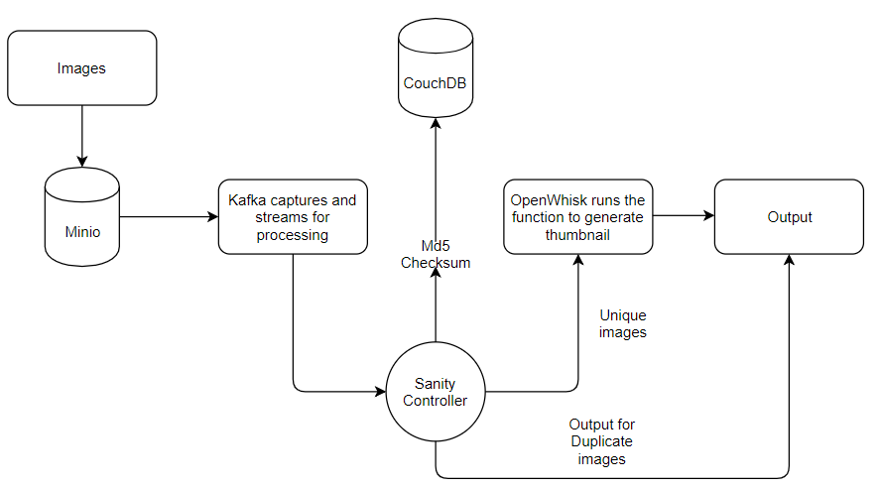
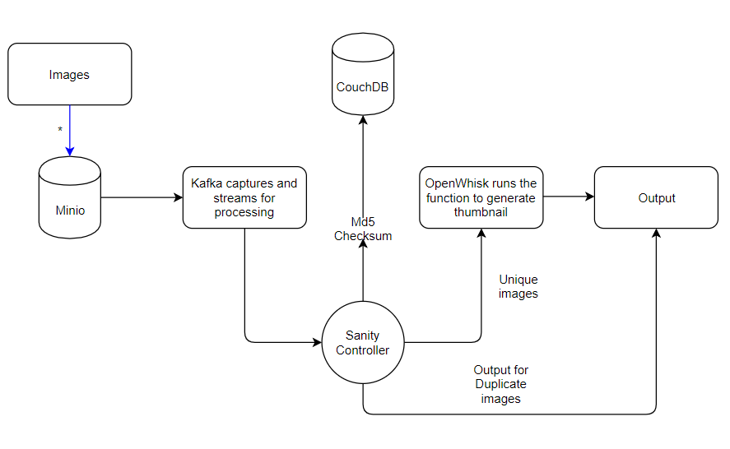
Architecture Diagram
data

Slide 5
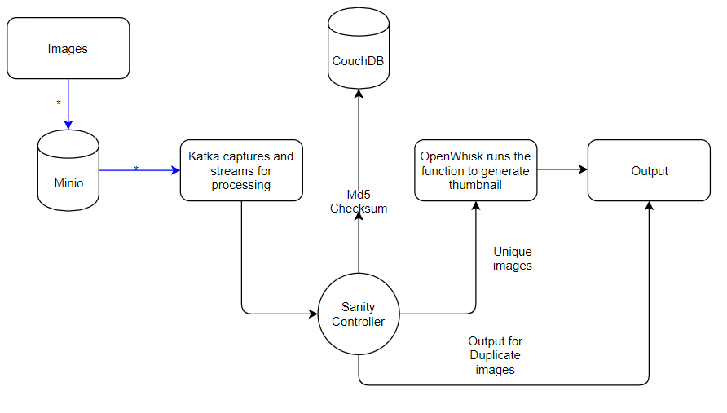
data

Slide 6
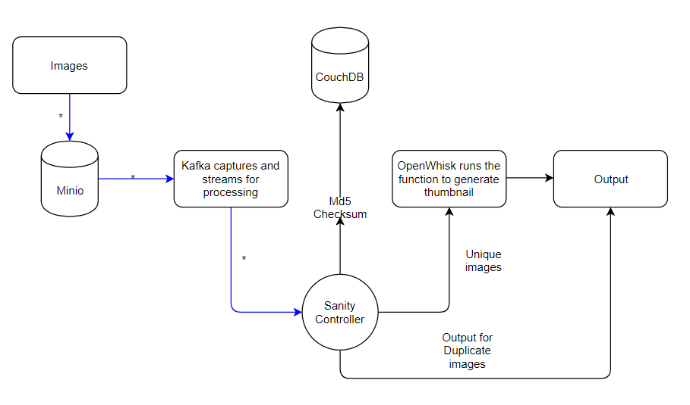
data

Slide 7
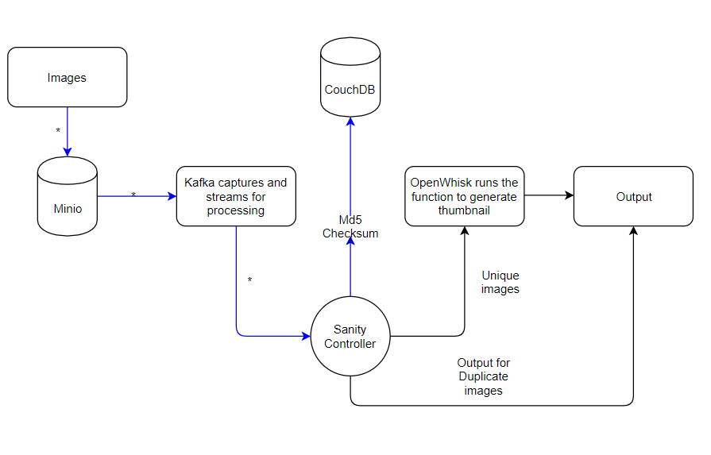
data

Slide 8
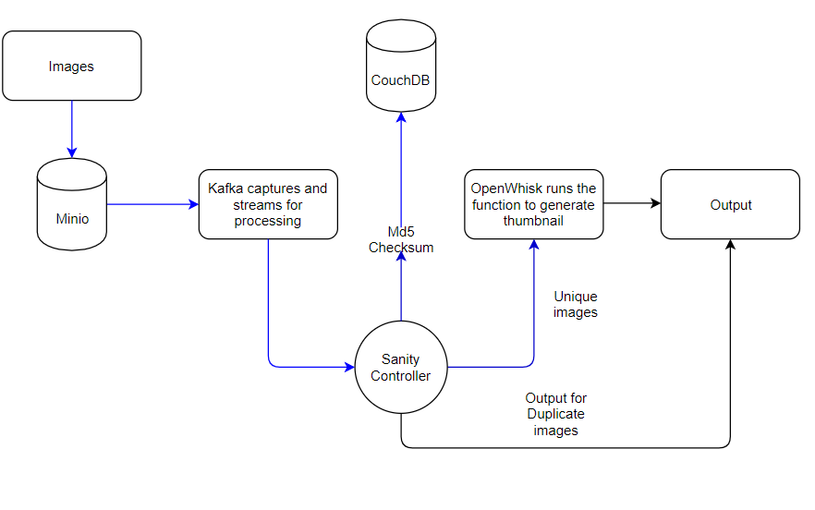
data

Slide 9
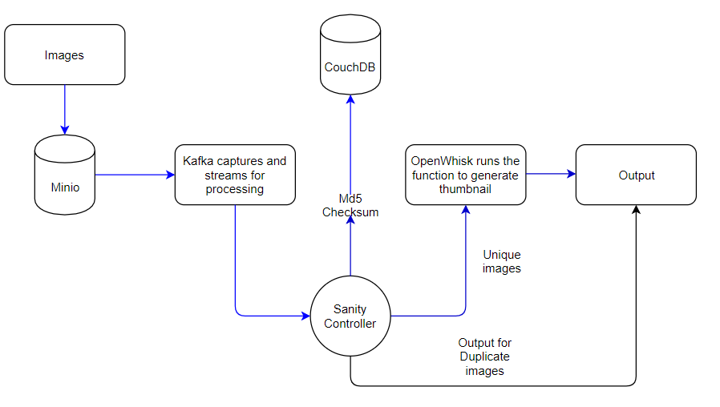
data

Slide 10
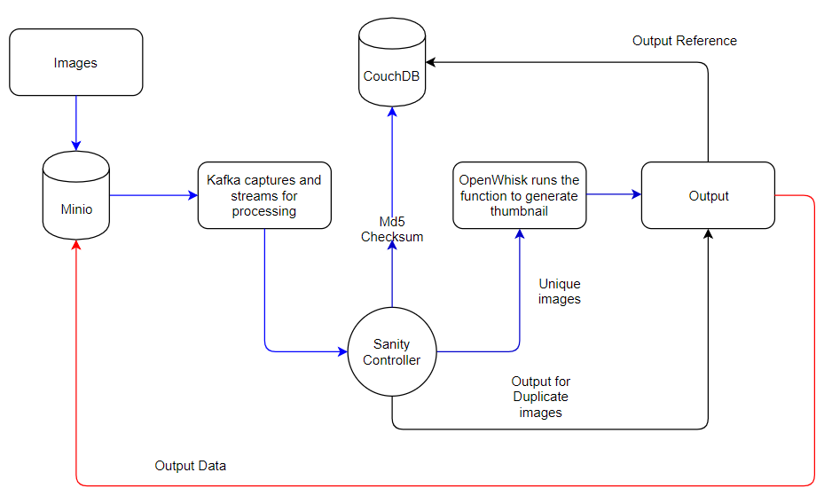
data

Slide 11
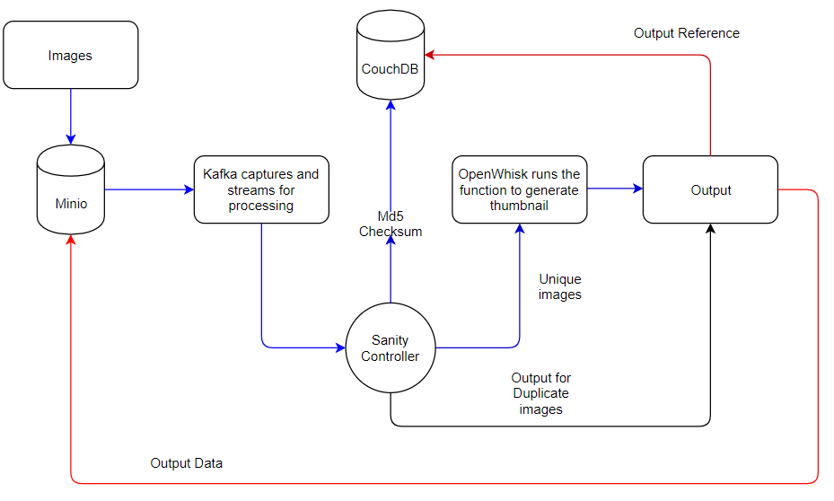
data

Slide 12
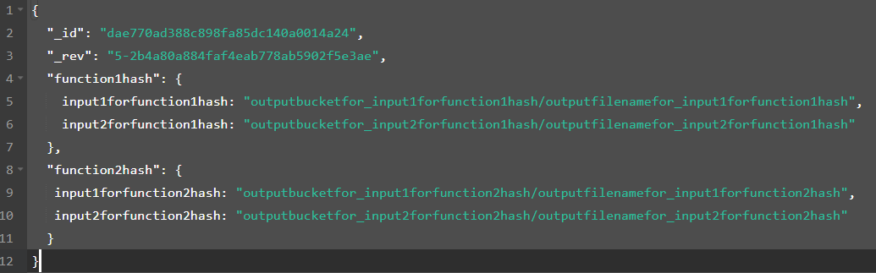
Couch DB
input_checksum
output_bucket/output_file

Slide 13
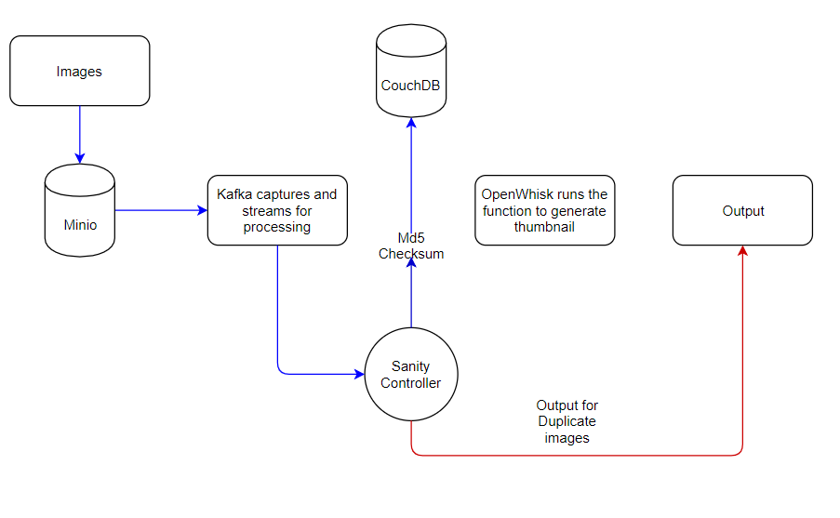
data

Slide 14
What did we achieve in this sprint?
Generalizing our architecture for handling any kind of incoming data for deduplication
Benchmarking our architecture on performing different use cases with and without deduplication functionality
Designing the CLI

Slide 15
Generalizing Sanity Framework (Using Checksum)
Json
Video
Sanity
Deduplication
Image
Text

Slide 16
FINDINGS

Slide 17
Benchmarking
Currently, IBM Cloud charges 0.00002 dollars for single execution of a function in cloud (per sec)
Imagine, if we try to invoke the same functions across with same data hitting 100,000 times, it would cost around 2 dollars for a single use case and if the cluster which has multiple functions scales up, cost would go too much.
Sanity would help save this execution multiple times and also potentially a lot of money.

Slide 18
Benchmarking Contd.
In Word count example, the unique function takes around 0.69 sec
In Video compression, the unique function takes around 2 sec.
In Weather api example , the unique function takes around 0.5 sec.

Slide 19
Next Steps (Sprint - 5)
Integrating the CLI with Sanity Framework
sanity --i <input_bucket> --o <output_bucket> --f <function_name>

Slide 20
Function
Create
User
OpenWhisk
Deploy

Slide 21
User
sanity --i input --o output --f function

Slide 22
sanity --i input --o output --f function
Input
Output
Sanity
Waits
Data

Slide 23
Data
Sanity
Calculates Checksum
Duplicate Data
Unique Data
Output
OpenWhisk

Slide 24
Next Steps (Sprint - 5) Contd.
Explore other benchmarking methods and compare with the existing framework
Brainstorm with mentor regarding the stretch goals
Detect the outputs for an arbitrary function

Slide 25
Challenges in Current Sprint
Configuring custom docker components for executing functions in them
How can we invoke custom docker scripts in openwhisk using parameterized input?
Debugging actions inside the openwhisk

Slide 26
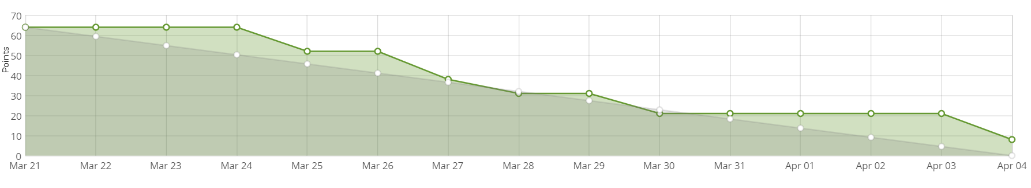
Burndown Chart

Slide 27
THANK YOU

